Slide 1
Logic Families

Slide 2
A "logic family" may also refer to a set of techniques used to implement logic within VLSI Integrated Circuits (IC)

Slide 3
Types
CMOS – complementary
metal-oxide metal-oxide- transistors
semiconductor logic based on
semiconductor field effect (MOSFETs).
TTL – transistor-transistor logic based on bipolar transistors.
ECL – emitter coupled logic based on bipolar transistors.

Slide 4
Basic Characteristics of Logic Families
The main characteristics of Logic families include:
  Speed
  Fan-in
  Fan-out
  Noise Immunity
  Power Dissipation

Slide 5
Contd..
Speed: Speed of a logic circuit is determined by the time between the application of input and change in the output of the circuit.
Fan-in: It determines the number of inputs the logic gate can handle.
Fan-out: Determines the number of circuits that a gate can drive.
Noise Immunity: The circuit ability to tolerate noise voltages at its inputs.
Noise margin is a quantitative measure of noise immunity.
Power: When a circuit switches from one state to the other, power dissipates.

Slide 6
General Characteristics of Basic Logic Families
CMOS consumes very little power, has excellent noise immunity, and is used with a wide range of voltages.
TTL can drive more current and uses more power than CMOS.
ECL is fast, with poor noise immunity and high power consumption.

Slide 7
Complementary metal oxide semiconductor (CMOS)
most widely used family for large-scaledevices
combines high speed with low powerconsumption
usual y operates from a single supply of 5 – 15V
excellent noise immunity of about 30% of supply voltage
can be connected to a large number of gates (about 50)
many forms – some with t down to 1ns
PD
– power consumption depends on speed (perhaps 1 mW

Slide 8
Transistor-transistor logic (TTL)
based on bipolar transistors
one of the most widely used families for small- and medium-scale devices – rarely used for VLSI
typically operated from 5Vsupply
typical noise immunity about 1 – 1.6V
many forms, some optimised for speed,power, etc.
high speed versions comparable to CMOS(~ 1.5 ns)
low-power versions down to about 1mW/gate

Slide 9
Emitter-coupled logic (ECL)
based on bipolar transistors, but removes problems of storage time by preventingthe transistors from saturating
very fast operation - propagation delays of 1ns or less
high power consumption, perhaps 60 mW/gate
low noise immunity of about0.2-0.25 V
used in some high speed specialist applications, but now largely replaced by high speedCMOS

Slide 10
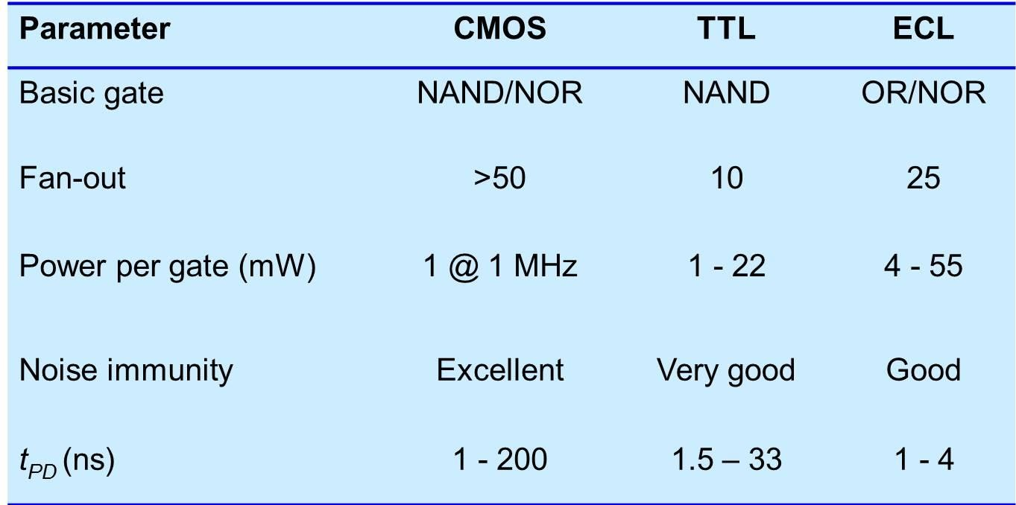
A Comparison of Logic Families

Slide 11
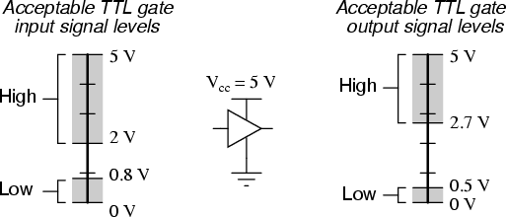
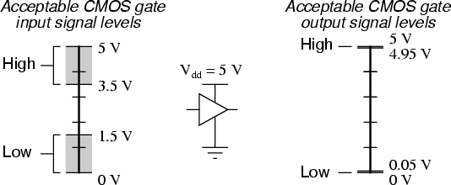
Logic Signal Voltage Levels

Slide 12
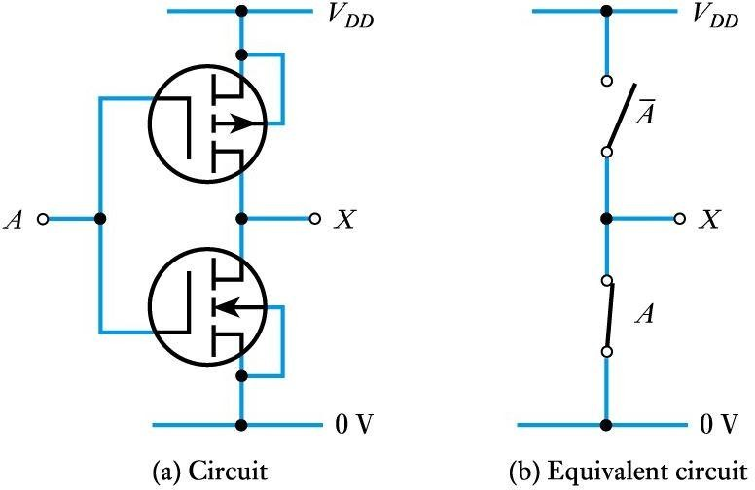
A CMOS inverter
PMOS
NMOS
Nmos if 0 it is off Nmos if 1 it is On Pmos if 0 it is on Pmos if 1 it is Off

Slide 13
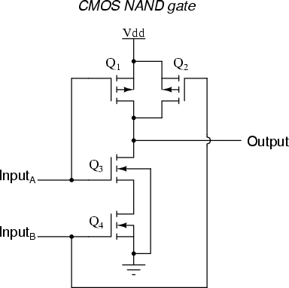
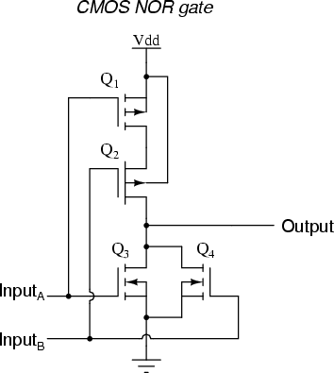
CMOS gates
Nmos if 0 it is off Nmos if 1 it is On Pmos if 0 it is on Pmos if 1 it is Off
If Pmos in parallel then Nmos in series and vice versa.
pmos
pmos
nmos
nmos

Slide 14
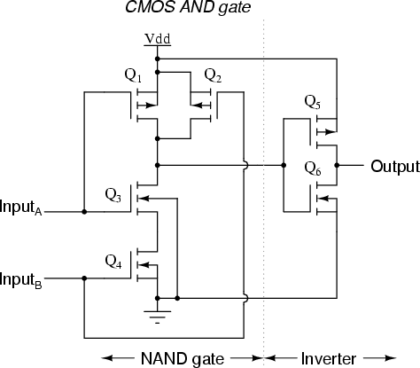
A CMOS AND Gate

Slide 15
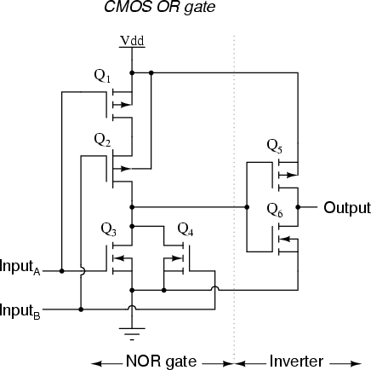
A CMOS OR Gate

Slide 16
Noise immunity
noise is present in all real systems
this adds random fluctuations to voltages representing logic levels
to cope with noise, the voltage ranges defining the logic levels are more tightly constrained at the output of a gate than at the input
thus small amounts of noise will not affect the circuit
the maximum noise voltage that can be tolerated by a circuit is termed its noise immunity, V_{NI}

Slide 17
